Slide 1
Help for KISI Key Infrastructure Services, Inc Hurricane Preparation and Response
Boolean Bombers
October 1, 2018

Slide 2
Hurricanes – some context
Hurricanes are the most severe form of tropical storms and in most cases have their genesis as a tropical depression that progresses to a tropical storm (winds 39-74 mph) and then into hurricane status (< 74 mph)
Hurricane season officially runs from June 1st until November 30th in the northern hemisphere.
When hurricanes strike the mainland (making landfall) they can cause significant in some cases catastrophic damage to property, critical infrastructure and loss of life.
Their trek onto the mainland can also result in damages from tornadoes and flooding.
Hurricanes are categorized based on their windspeed and during their lifespan can increase and decrease in size and strength. Their strength is measured on a scale referred to as the Saffir-Simpson scale.

Slide 3
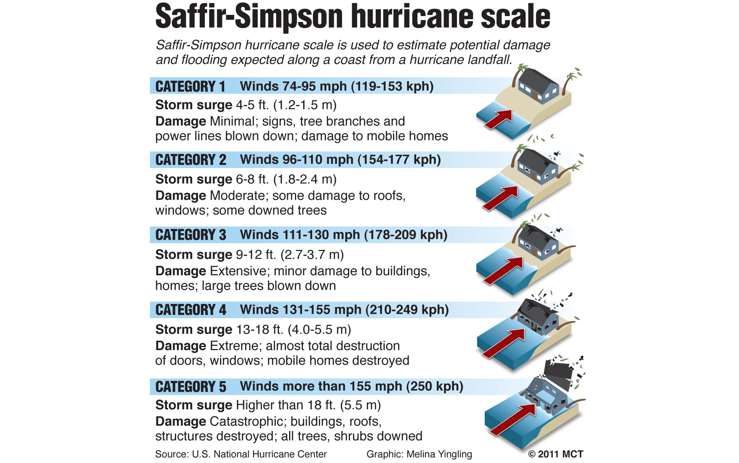

Slide 4
2018 Hurricane Season – Risks to the SE US
KISI is a provider of critical infrastructure services to the southeastern US. Given the risk that hurricanes represent they have contracted with the Boolean Bombers, a wholly owned subsidiary of GSU’s Robinson College of Business. Experts in the field of ‘big data’ analytics, the team assigned is being called upon to help KISI both prepare and respond to the impacts from Atlantic and Caribbean storms.
Shortly following their engagement by KISI the team was called upon to help the KISI senior management team prepare for Hurricane Florence. Florence began as a tropical disturbance off the coast of north Africa in late August with sustained winds at that time of approximately 30 mph. Several days prior to projected landfall it had reached a Category 4 level with sustained winds of over 140 mph.
The team has developed a 1) predictive model forecasting the location of landfall for Florence and 2) projected wind speeds and a means 3) forecast the impact of power outages and 4) a means to deploy a limited fleet of generators to help support delivery of KISI’s services within areas directly impacted by the storm despite the anticipated loss of commercial power.

Slide 5
Boolean Bombers – background and approach
Shortly after contracting with KISI the Boolean Bombers, expertly armed with skills and tools from their experiences within Data Programming for Big Data - CIS 8005, the team began to gather data relevant to their efforts to aid KISI in their preparation for Hurricane Florence.
In addition to gaining insight into the nature and path of Hurricane Florence the team gathered data regarding the SE US in terms of location and population distribution across the region. Additionally, the team gathered extensive data from NOAA, the tropical storm wing of the National Weather Service on Atlantic Tropical storms from 1851-2015. The team also reviewed several analyses prepared previously studying SE tropical storms.
The team performed a series of cleansing and transformation operations to data gathered and dispatched a portion of the team to become expert in data representation, specifically the use of BaseMap a mapping capability available within Python’s MatPlot library.
To increase your learning the team is prepared to share with you a preliminary version of their briefing materials prepared for their readout to KISI’s senior leadership team.
Given time constraints we would ask that you hold questions (and applause) until the team has had a chance to share the majority of their analysis.

Slide 6
https://www.youtube.com/watch?v=W3ghU4e2OKY

Slide 7
Appendix

Slide 8
https://weather.com/storms/hurricane-central/AL062018

Slide 9
https://www.nhc.noaa.gov/archive/2018/FLORENCE_graphics.php?product=5day_cone_no_line

Slide 10
https://www.nytimes.com/interactive/2018/09/13/us/hurricane-florence-impact-damage-map.html

